Slide 1

Storytime
Sam Peake

Slide 2

Storytelling is no longer a feature of daily life.
Computers
Television
Smart phones
DVDs
YouTube
ROBLOX
Etc…

Slide 3

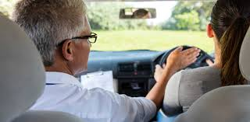
In far too many settings, storytime is still a limited activity that conveniently fills a fifteen-minute gap before lunch or home time.
Neil Griffiths

Slide 4
The freedom to choose your own texts, discover a world of information, adventure and be transported into real and imaginary worlds, visiting the past present and future. A chance to dream.
Neil Friffiths
Excitement for reading
inference
grammar
predicting
visual decoding
phonetic awareness
word recognition

Slide 5

Attitudes to books
Reading motivation

Slide 6

How to make story time count.

Slide 7
Are you sitting comfortably?
Environment?
Indoors or outdoors?
Quality text?
Special?
Links?

Slide 8
Preparation
Introduction
Delivery
Interaction
Review

Slide 9
Preparation
mood
Read it yourself
Plan questions
Identify key moments/ look for opportunities
Plan children’s involvement
Plan your involvement
Body language
excitement

Slide 10
INTRODUCTION
Hints
Clues
Questions
Prior knowledge
Sensory experience
Raising expectations
Sharing the love
Hiding the book
Cover, title, author
TASK -Think of 3 books and 3 sensory experiences to match.

Slide 11
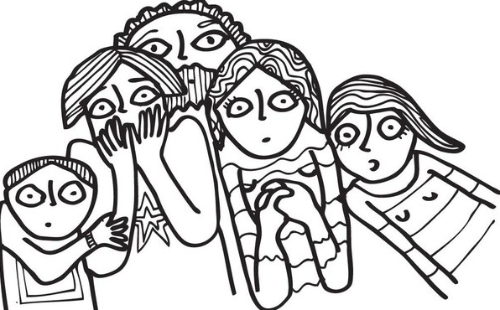
Delivery ‘VOICE’
The voice is the storyteller’s primary instrument
– the words are the notes.
Eric Madderrn
Avoid reading at the same level
Change volume, pace ,tone and pitch
Clear diction
Enlarge your voice.
Build suspense by reading slowly
Build excitement by reading quickly

Slide 12

Delivery ‘GESTURE’
Use your body like a giant paintbrush or sparkler to draw images in the air.

Slide 13
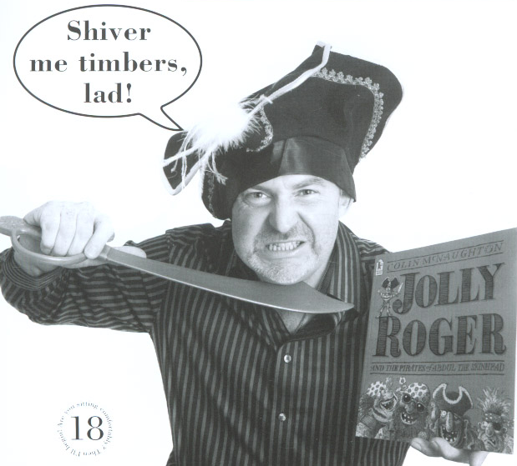
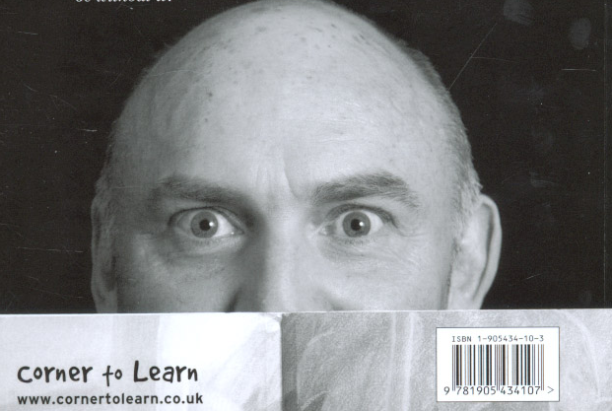
Express mood, shrug shoulders, clenched fists, shake the body.
Turn the pages at different speeds.
Peep over the pages
Wave the book, shake the book.

Slide 14
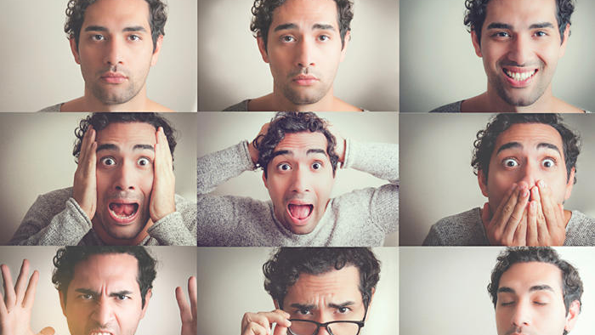
Delivery ‘FACIAL EXPRESSION’
Storytelling is no place for inhibition!

Slide 15
MOVEMENT & INTERACTION
There is a time for snuggling up with a book but…
Move slowly towards the audience
Rush, jump, slither, twirl
Stand, sit, lie, curl up
Move around as the characters do
Ask questions
Encourage prediction
Sound effects
Join in with repeated phrases,
Delivery ‘FACIAL EXPRESSION’

Slide 16
Review
Questions to ask the children when a story is finished.
TASK Make a list!

Slide 17
Summary
Give it the time it deserves
Be in a positive mood
Tell children about the books you love (update ‘I am reading’ boards)
Build up the suspense before a book
Use props
Use body language
Hold the book in a positive way
Move around
Use facial expressions
Think about volume, tone and speed
Ask questions
Predict
Sound effect
Ad-lib
Share the enjoyment

