Slide 1
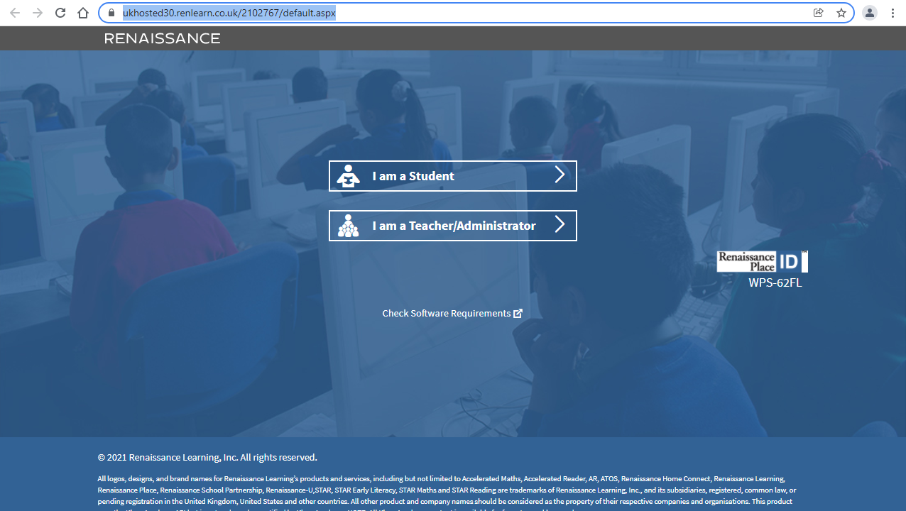

Slide 2
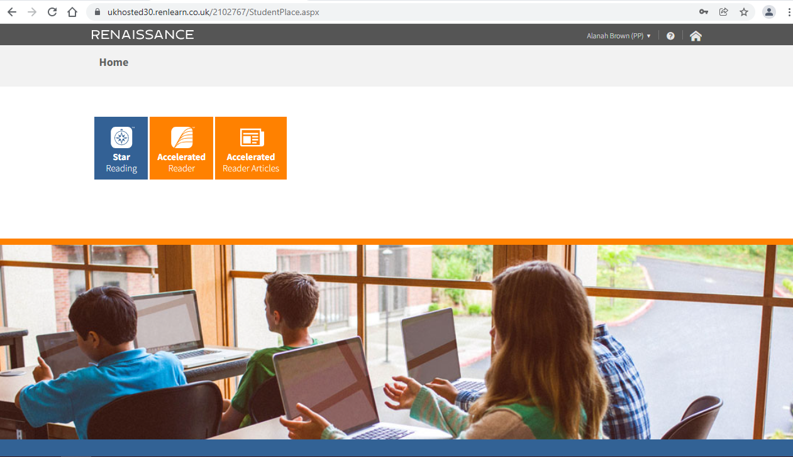

Child’s name
Children choose this button to enter the quiz part of Accelerated reading

Slide 3
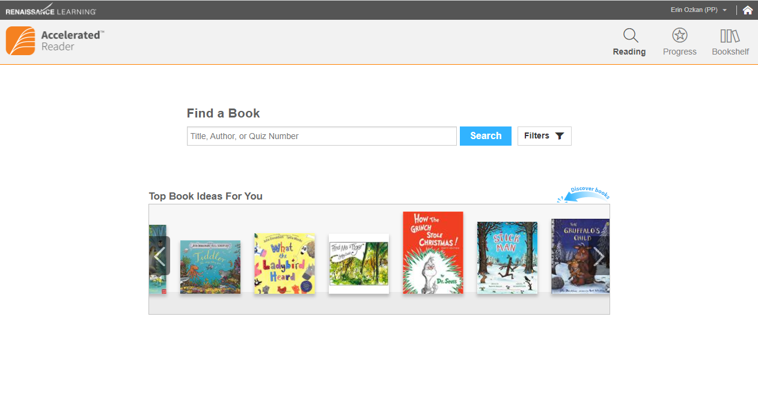
Child’s name
What could I read next by the same author? Could I quiz on this book?
Reading page
Children can use this page to:
- Search for a book to quiz on by different authors.
Check if they have already quizzed on a book that they want to read next.
See if a book that they have read for pleasure is on Accelerated Reading, so that they can also take a quiz on it.

Slide 4
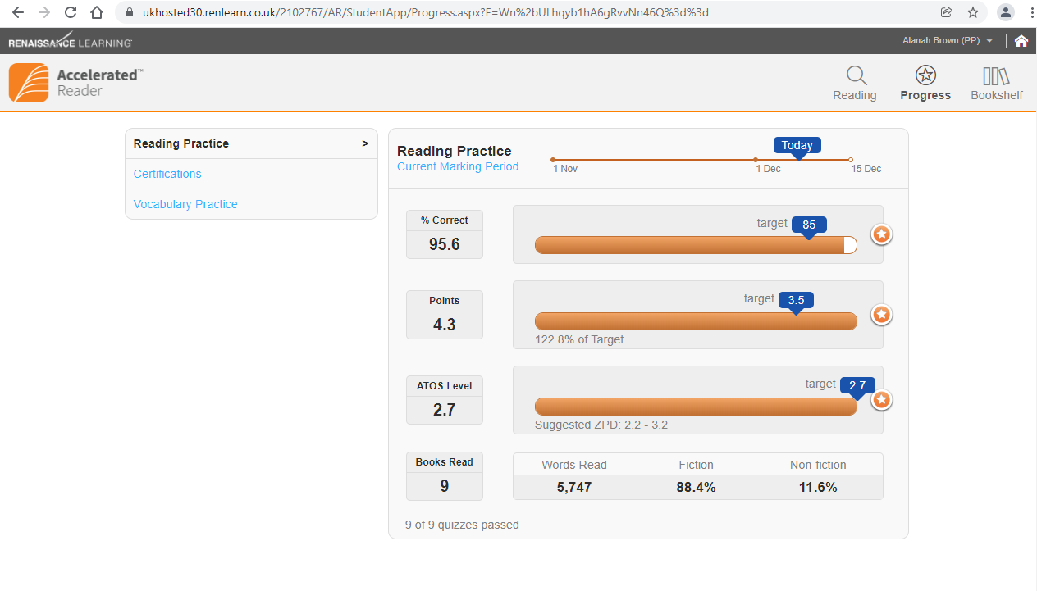
Child’s name
How am I doing?
Progress
Page
% of correct answers
Target = 85% (blue bubble)
Total points earned from quizzing
[Half-term Target = see blue bubble]
Progress
bars
Average difficulty for each book read
[Half-term Target (ZPD) = see blue bubble]
Number of books read this half term.

Slide 5
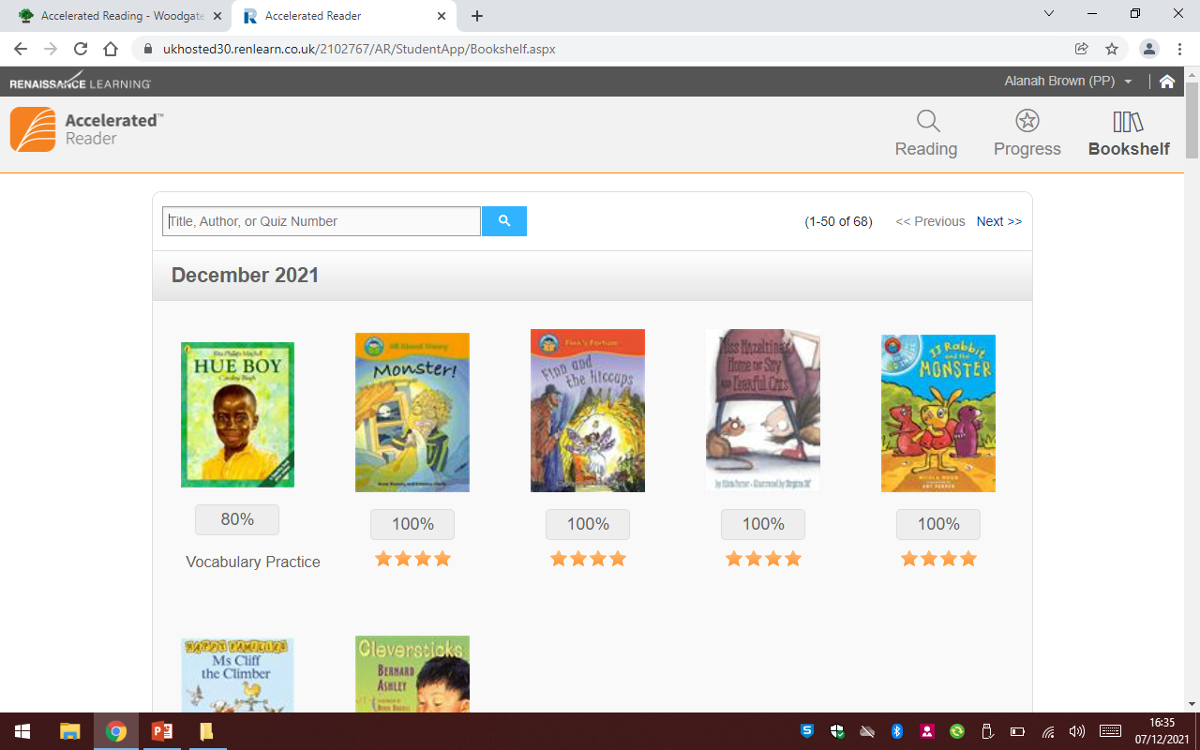
Child’s name
Which books have I already read?
bookshelf
Page

